Slide 1
PAVE: Pain and Accuracy Video evaluation of Exercises
TEAM 2
Final presentation
OF ITSS Project Module
Chwa Choon Xiang
Benjamin Quek
Gerard Ong

Slide 2
Introduction
Physical care and rehabilitation is of importance in an ageing society in Singapore. There is a growing demand for healthcare services to attend to these medical needs.
Physical evaluation tests for patients although important (especially for groups such as elderly in Singapore), is unfortunately of lower priority. There may also be a need to minimize contact between patients.
An automated vision system for physical ability assessment can resolve the problem mentioned
Physical ability evaluation consists of the accuracy or performance of the exercise test, and level of pain or discomfort during the test.
Notes:
What is the business problem that you will investigate?
Why is it interesting and useful?
What is its impact to Singapore?

Slide 3
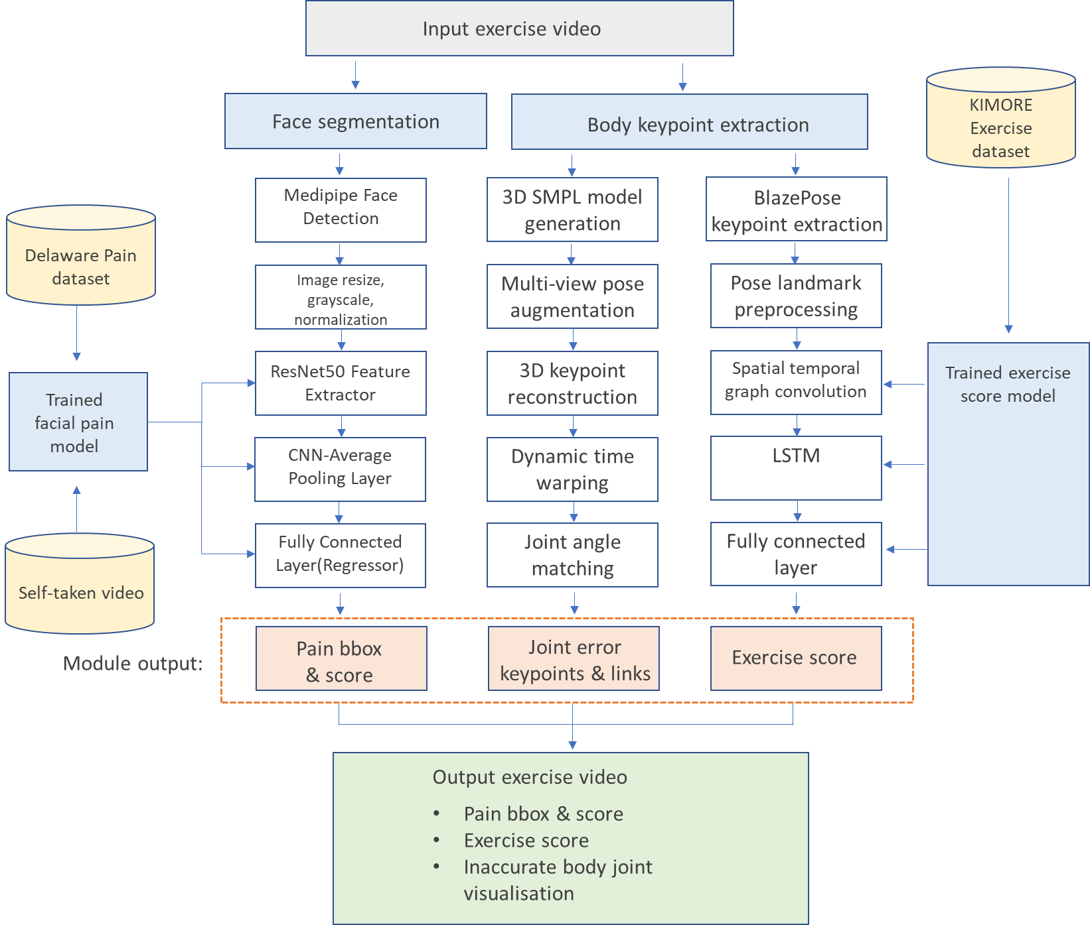
System Flow Chart
Notes:
What is the business problem that you will investigate?
Why is it interesting and useful?
What is its impact to Singapore?

Slide 4
PAIN SCORING

Slide 5
Pain Scoring
Literature Review:
Automatic vs. Human Recognition of Pain Intensity from Facial Expression on the X-ITE Pain Database is conducted to recognize pain intensity from frontal faces in videos.
Enhanced deep learning algorithm development to detect pain intensity from facial expression images to detect the pain intensity in human by using a facial expression video image.
Dataset
The Delaware pain database: A set of painful expressions and corresponding norming data
A collection of 229 unique painful expressions from different age groups, races, and genders.
Pain Expression is the average rating of pain for a given expression made by a particular target
Expression Highest is the categorical variable to represent the most possible expression on face as the classification data
Self-Recorded Videos: pain_correctpose.mp4 and nopain_incorrectpose.mp4
Notes:
What is the business problem that you will investigate?
Why is it interesting and useful?
What is its impact to Singapore?

Slide 6
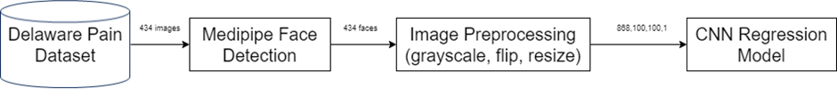
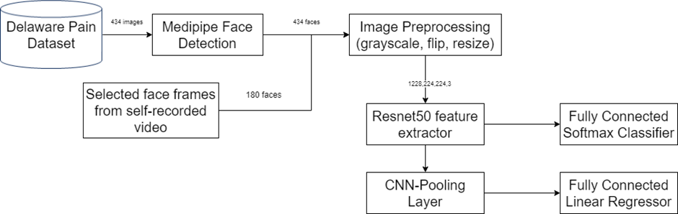
Pain Scoring
Proposed architecture:
Extraction of the pain expression from the self-recorded video frame.
Training of the ResNet50-CNN Classifier and Regressor.
Prediction of the pain scoring of videos pain_incorrectpose.mp4 and nopain_correctpose.mp4
Notes:
What is the business problem that you will investigate?
Why is it interesting and useful?
What is its impact to Singapore?

Slide 7
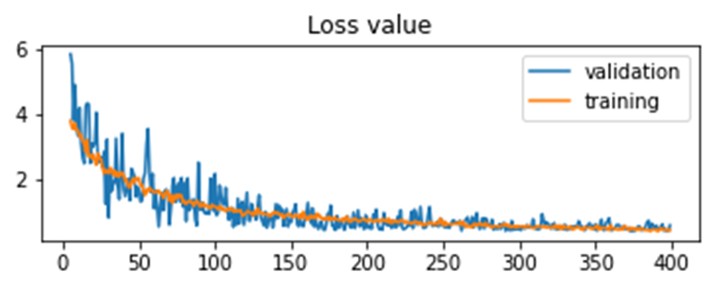
Pain Scoring
CNN Regression Model:
Training with 400 epochs with a learning rate of 1e-4 and batch size of 24.
The mean square error of the validation dataset can converge at the end of the model training to hit 0.45 in average.
Achieve a test score(mse) of 0.38 on the Delaware Pain Database.
Notes:
What is the business problem that you will investigate?
Why is it interesting and useful?
What is its impact to Singapore?

Slide 8
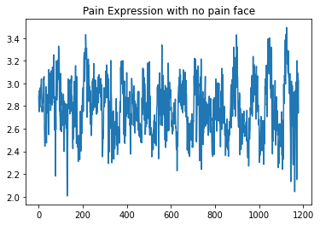
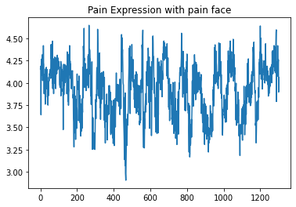
Pain Scoring
CNN Regression Model
Due to high variance of the pain expression and least disparity between two videos with opposite class.
Deduction on the score(mse) of 0.38 on predicted expression of each frames of nopain_incorrectpose.mp4.(training video)
Increment on the score(mse) of 0.38 on predicted expression of each frames of pain_correctpose.mp4. (training video)
Trained the ResNet50-CNN Model with Delaware Pain Database
Notes:
What is the business problem that you will investigate?
Why is it interesting and useful?
What is its impact to Singapore?

Slide 9
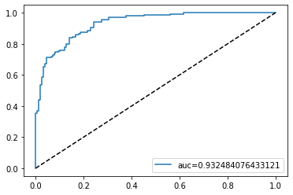
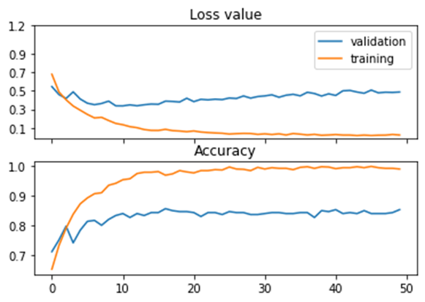
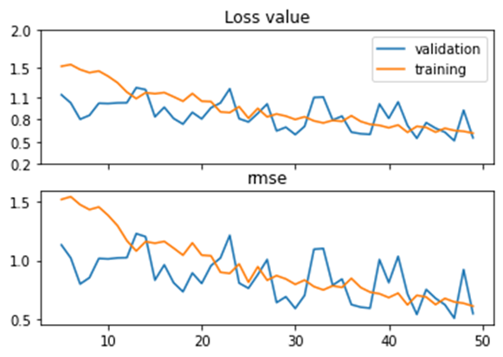
Pain Scoring
ResNet50-CNN Model:
Training with 50 epochs, learning rate of 1e-4 and batch size of 24.
Hit an average of 1.0 on the validation loss, which is derived from the combination of the categorical cross-entropy on the classifier and mean square error on the regressor.
Accuracy: 84.04%, AUC: 0.932, MSE: 0.512
classifier
regressor
Notes:
What is the business problem that you will investigate?
Why is it interesting and useful?
What is its impact to Singapore?

Slide 10
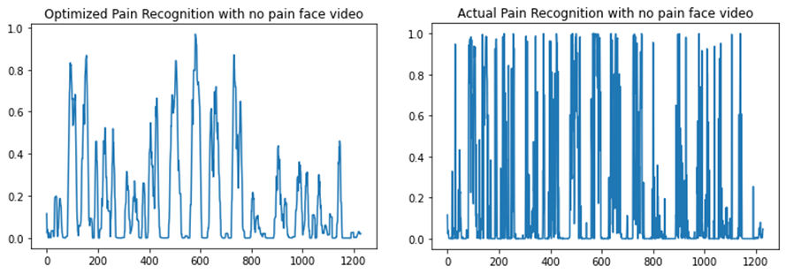
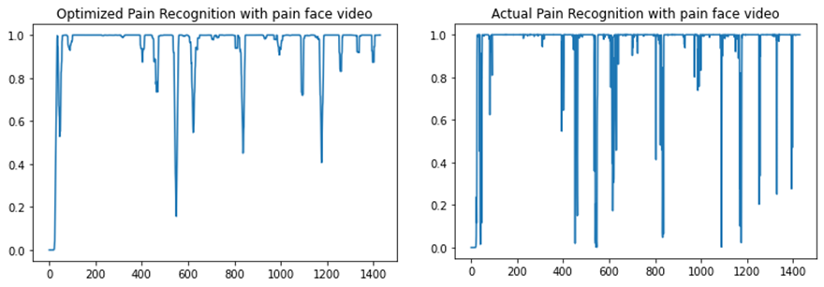
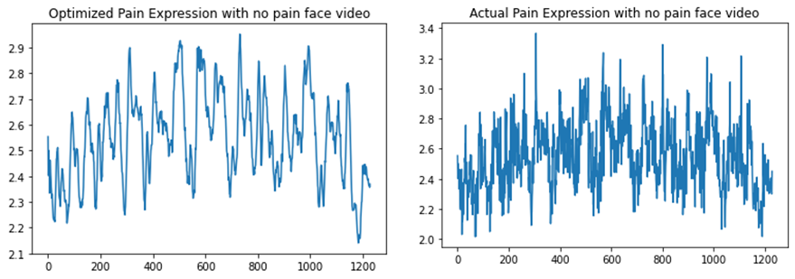
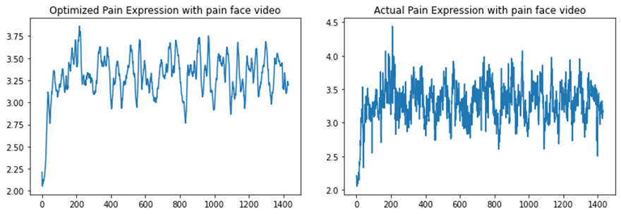
Pain Scoring
Experiment Results
Apply double ended queue with length 10. 2.8 as the cutoff threshold.
nopain_correctpose.mp4.(testing video): 91% of no pain detected frames with an average mean of 2.55 on the predict pain expression.
pain_incorrectpose.mp4 (testing video): 97% of pain detected frames with an average mean of 3.29 on the predict pain expression.
nopain_correctpose.mp4
pain_incorrectpose.mp4
Notes:
What is the business problem that you will investigate?
Why is it interesting and useful?
What is its impact to Singapore?

Slide 11
Pain Scoring
Limitations
Any external inconsistency on the images may affect the performance of the model, eg accessories worn on face.
Lighting effect and resolution of the face captured.
Overfitting of the deep learning model.
Possible Solutions:
Machine Learning Feature Extraction: LBP, HoG, Face Mesh.
Expansion of the image database.
Notes:
What is the business problem that you will investigate?
Why is it interesting and useful?
What is its impact to Singapore?

Slide 12
Exercise scoring

Slide 13
Exercise Scoring
Literature Review - datasets
Dataset name | Type of exercises | Details | Data sources
SPHERESitStand2015 (Tao et al., 2016) | Sit to stand | 109 sequences, 10 individuals, restricted knee, hip, freezing | Kinect/ Kinect SDK, OpenNI SDK skeleton
TRSP (Dolatabadi et al., 2017) | Stroke, compensatory movement | 10 healthy, 10 stroke 4 compensatory movements | Kinect, Haptic robot/ Kinect SDK skeleton
Parkinson’s pose estimation (Li et al., 2018b) | PD, LID, UPDRS assessment tasks | 526 sequence, PD, LID patients, 4 UPDRS assessment tasks | RGB Camera/ CPM (Wei et al., 2016) skeleton
UI-PRMD (Vakanski et al., 2018) | General rehabilitation exercises | 10 subjects, 10 exercises, 10 repetitions | Kinect Vicon/ Kinect SDK skeleton
KIMORE Dataset (Capecci et al., 2019) | Stroke, PD, back pain exercises | 44 healthy, 34 patient subjects, 5 exercises 5 repetitions | Kinect/ RGB, depth, skeleton
Notes:
Table is a summary of publicly available datasets we have identified in relation to rehabilitative exercises
Dataset with categories of both healthy and unhealthy patients - To ensure that the model learns from both and can discern one from another
Dataset with RGB data available – Our solution must allow users to use any ordinary camera to capture themselves performing the rehabilitative exercise, this is so that the solution can be widely adopted without the need for users to purchaser specialized equipment to use (e.g., Kinect/depth-sensing cameras)

Slide 14
Exercise Scoring
Literature Review - approaches
Name | Technology | Strengths | Weaknesses
Yoga tutor visualization and analysis using SURF algorithm | SURF | Fast feature extraction | Newer, more accurate methods to obtain keypoints via Deep Learning (OpenPose, BlazePose) are available
Development of a yoga posture coaching system using an interactive display based on transfer learning | Keypoint angle-based | Computationally cheap (logic-based solution) | Possibility of oversimplifying the problem of scoring rehabilitation exercise performance to one variable: joint angles
Tele-EvalNet: A Low-cost, Teleconsultation System for Home based Rehabilitation of Stroke Survivors using Multiscale CNN-LSTM Architecture | Multiscale CNN-LSTM | CNN works as a feature extractor before running LSTM which has capability to accept variable input lengths | Unsure if features extracted by CNN are the best for modelling the problem (Black box)
Spatial Temporal Graph Convolutional Networks for Skeleton-Based Action Recognition | Spatial Temporal Graph Convolutional Networks (ST-GCN) | Leveraging natural connection between joints lead to better feature extraction (Less of a black box) | Cannot accept variable length inputs
Graph Convolutional Networks for Assessment of Physical Rehabilitation Exercises | ST-GCN-LSTM | Combining the feature extraction from GCN with variable length input capability of LSTM
Notes:
The table is a summary of different approaches explored that are related to exercise feature extraction and inference
We selected the Graph Convolutional Network - LSTM as the method to investigate as it combined the feature extraction method of spatial temporal graphs which leverage natural connections between joints in the body and the variable input capability of LSTMs

Slide 15
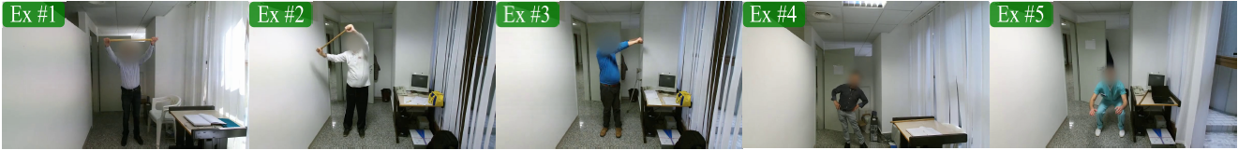
Exercise Scoring
Dataset introduction
In total for the KIMORE dataset, there were a total of 78 subjects for each of the 5 exercises and below is breakdown of the groups:
17 Experts
27 Non expert but healthy (NotExpert)
10 Stroke patients
15 Parkinson disease patients
16 BackPain patients

Slide 16
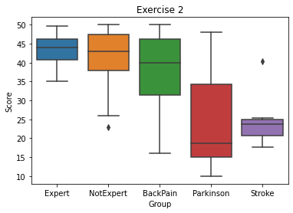
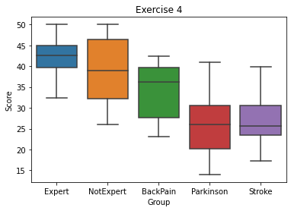
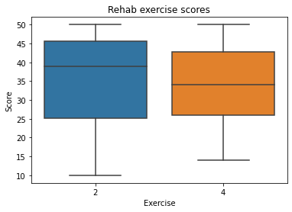
Exercise Scoring
Dataset analysis
Notes:
We performed some preliminary data analysis on the scores of the exercise 2 and 4 as seen in figures, from here we can see that the scores are quite symmetrical across the different groups and exercises, with only the Parkinson's group in exercise 2 being more right skewed. There is also little to no outliers in the data, only having some in the NotExpert and Stroke groups of exercise 2.

Slide 17
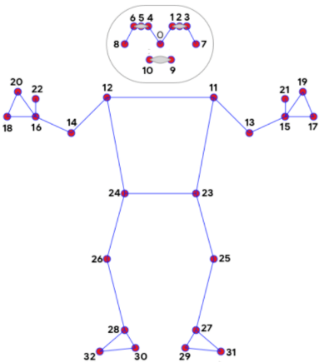
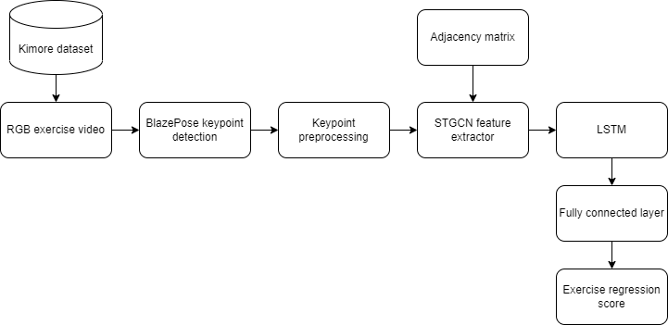
Exercise Scoring
Proposed architecture
Notes:
The adjacency matrix represents the joints and the associated intra-body connections within a single frame, it effectively is the graph in the STGCN framework.

Slide 18
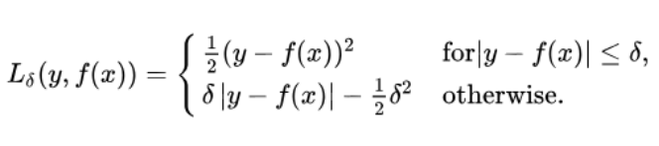
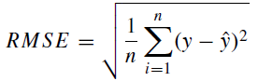
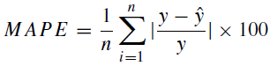
Exercise Scoring
Implementation details
Adam optimizer
Huber loss function
Performance metrics
Notes:
Root mean squared error
Mean absolute percentage error

Slide 19
Exercise Scoring
Experiment results
We first tried different LSTM configurations
Then we varied the number of epochs to optimize the training of our model
Thus, we utilized 150 epochs with an LSTM configuration of 80,60,40,40,40,60,80 and 0.35 dropout.
LSTM configuration | Dropout | RMSE | MAPE
80,40,40,80 | 0.25 | 8.95 | 21.85
80,40,40,80 | 0.35 | 8.84 | 21.05
80,60,40,40,60,80 | 0.35 | 8.39 | 20.28
Epochs | RMSE | MAPE
50 | 8.39 | 20.28
100 | 6.37 | 13.02
150 | 5.53 | 11.32
200 | 6.54 | 14.14
Notes:
We tried different LSTM configurations as the inference engine after using STGCN as the feature extractor. For this experiment we set the number of epochs to 50 for faster testing
We also varied the hyperparameter of epochs when trying to optimize the training of our model and similarly.
We got a RMSE of 5.53 and MAPE of 11.32 percent

Slide 20
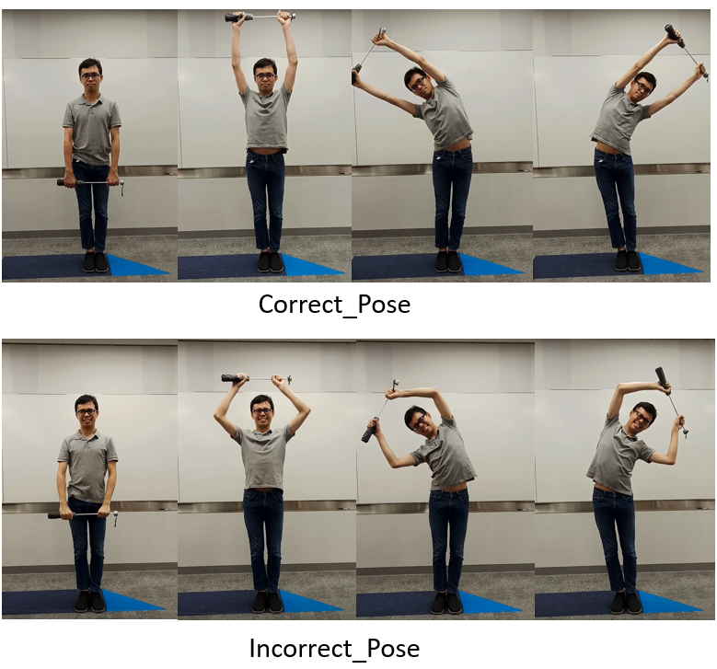
Exercise Scoring
Experiment results
We then tested the trained model with real world test videos of our team performing exercises 2 and 4 both “correctly” and “incorrectly”
Exercise 2
Exercise 4
Based on our test, our model has an error rate of 1/7 ~ 14.3%.
Person 1 |  | Person 2 |  | Person 3
Correct | Incorrect | Correct | Incorrect | Correct | Incorrect
40.98 | 32.52 | 38.85 | 31.72 | 38.36 | 24.60
 |  | 28.70 | 33.90
Person 1 |  | Person 2 |  | Person 3
Correct | Incorrect | Correct | Incorrect | Correct | Incorrect
41.82 | 31.81 | 30.63 | 30.26 | 42.09 | 41.60
Notes:
We utilize a logic that for the same person, if the score of themselves performing the exercise correctly is greater than that of incorrect performance, we count that as a correct prediction.
This corroborates with the MAPE of 11.32 percent that we obtained earlier using the test set of the KIMORE dataset.

Slide 21
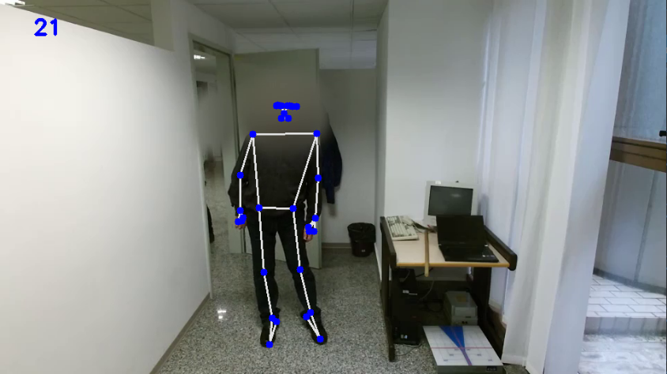
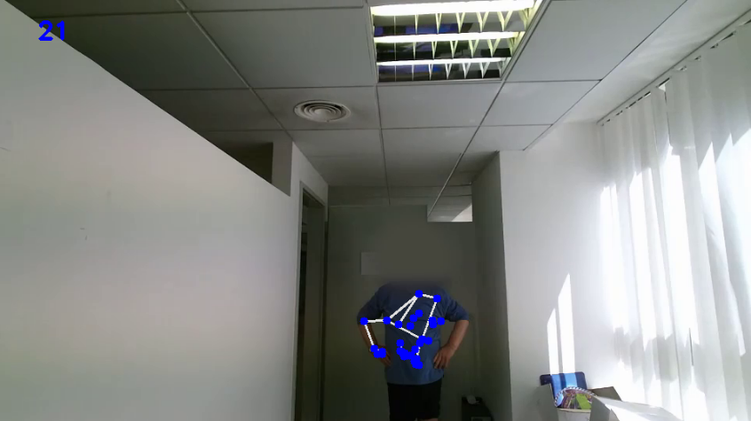
Exercise scoring
Limitations
There must be big enough movements such that the movement of keypoints across frames is enough for the model to learn from.
BlazePose unable to properly predict keypoints due to occlusion of body parts due to video angle/ missing head due to blurring.
Notes:
Due to the blurring of the face and occasional occlusion of sections of the body in the video dataset there are times when BlazePose is unable to generate properly arranged keypoints and instead generates noise

Slide 22
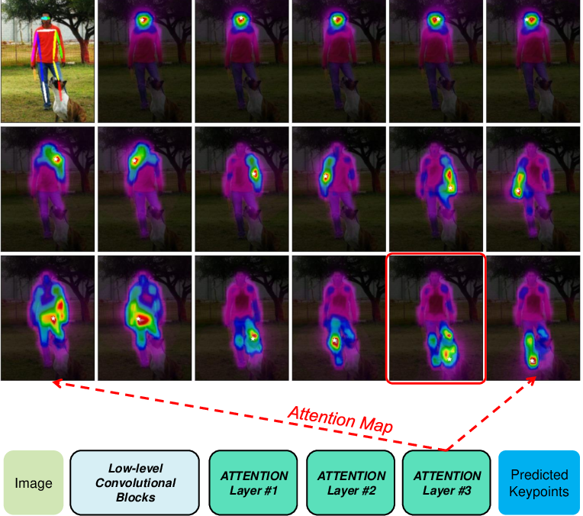
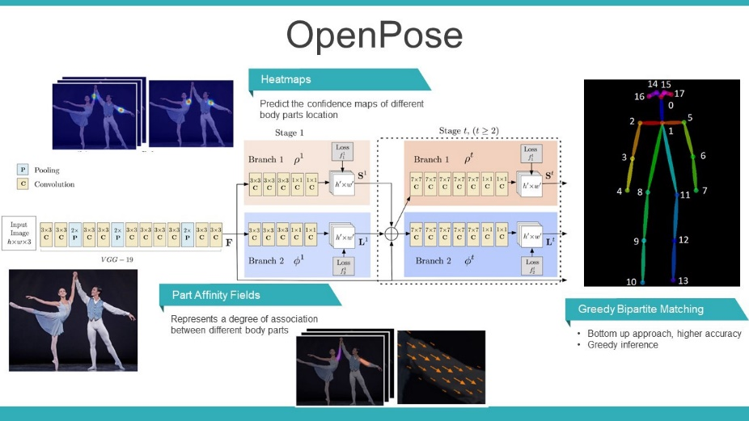
Pain Scoring
Future work:
Explore other methods to generate/estimate keypoints to improve stability
Expansion of the rehabilitation exercise video database
Explore alternative backbones that utilize the emerging transformer-attention mechanism in computer vision problems

Slide 23
Exercise pose matching

Slide 24
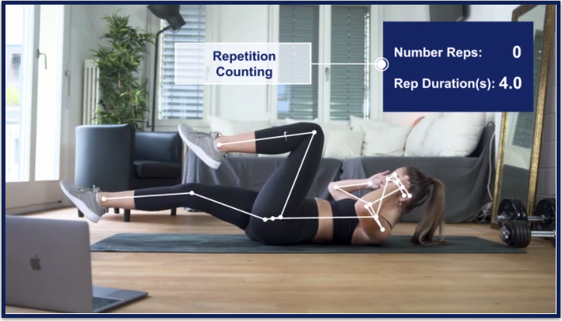
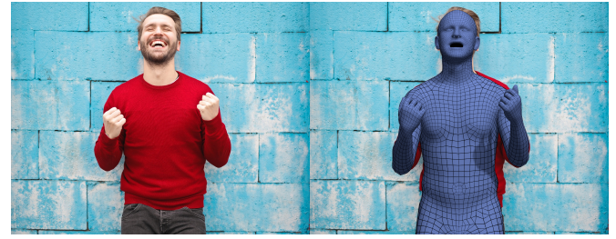
Exercise Pose Matching
Literature review
2D Pose estimation algorithms have been well explored and commercial products and literature works for real-time posture evaluation and repetition counting, have been developed. (E.g. Vay.ai, Kemtai)
3D Pose estimation is an area to improve on, especially for complex out-of-plane human body motions.
Recent developments in 3D human body shape modelling, such as ExPose (EXpressive POse and Shape rEgression), could be further extended for multi-view pose estimation and 3D keypoint reconstruction.
Vay.ai
ExPose
Notes:
What is the business problem that you will investigate?
Why is it interesting and useful?
What is its impact to Singapore?

Slide 25
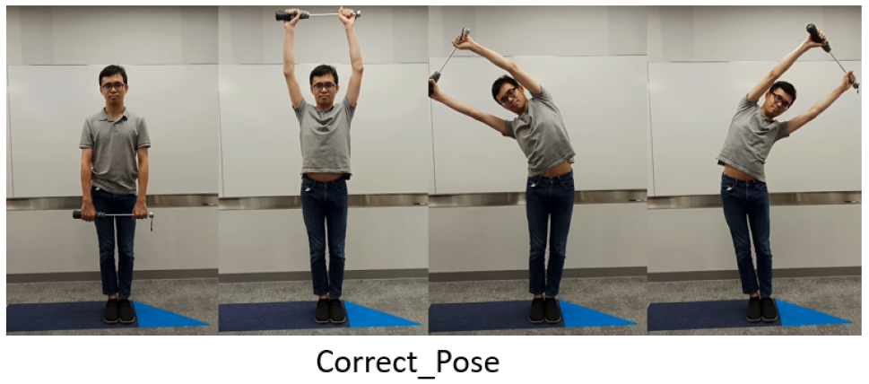
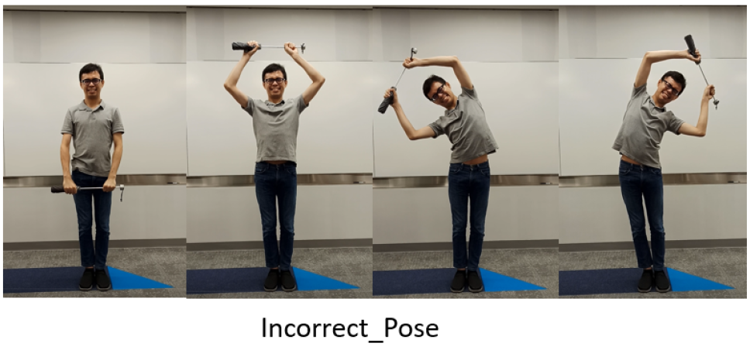
Exercise Pose Matching
Dataset
Self recorded videos:
Simulated error for arms
Minimal errors for other body joints
Errors not in all frames
Different exercise speeds (video lengths)
Simulated errors only when arms are raised
Notes:
What is the business problem that you will investigate?
Why is it interesting and useful?
What is its impact to Singapore?

Slide 26
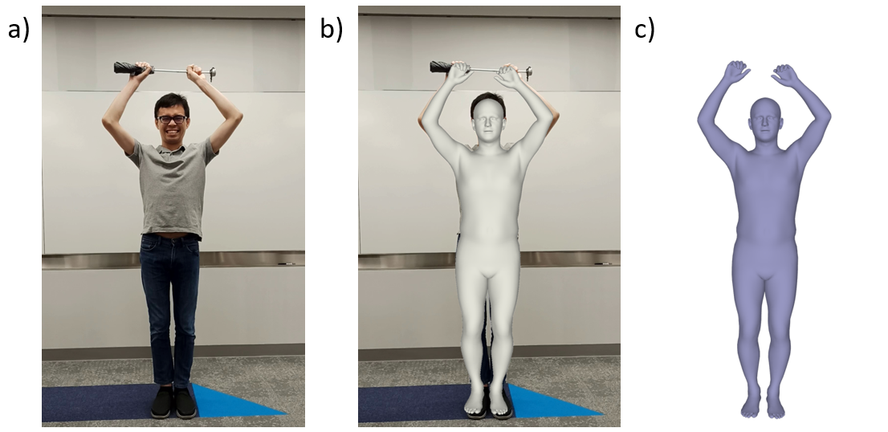
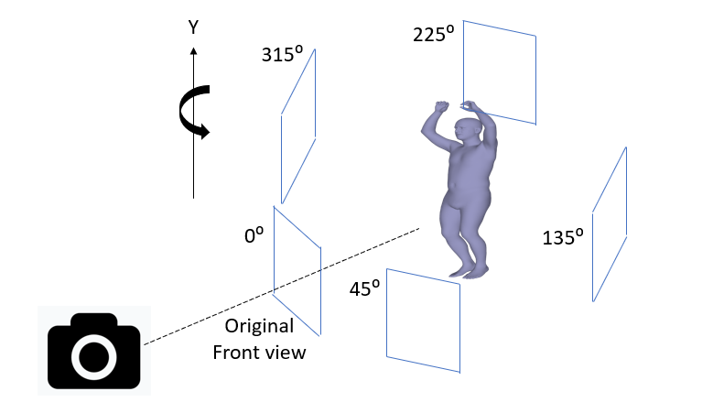
Exercise Pose Matching
Proposed approach:
3D human shape generation from monocular RGB image, using ExPose model.
3D model rotation and multi-view capture at 4 angles.
Notes:
What is the business problem that you will investigate?
Why is it interesting and useful?
What is its impact to Singapore?

Slide 27
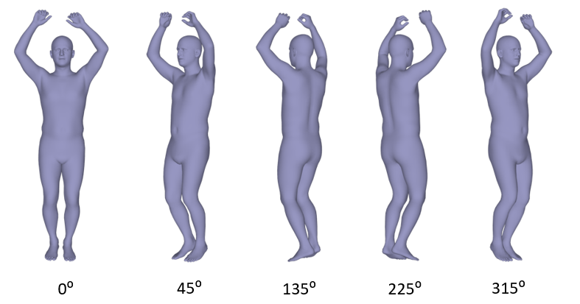
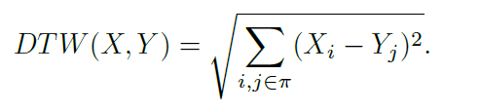
Exercise Pose Matching
Proposed approach:
Extract multi-view 2D RGB images for 3D keypoint reconstruction.
Temporal matching of different exercise speeds (video lengths)
Multi-variable Dynamic Time Warping (DTW)
Generate path for frame-to-frame matching
Notes:
What is the business problem that you will investigate?
Why is it interesting and useful?
What is its impact to Singapore?

Slide 28
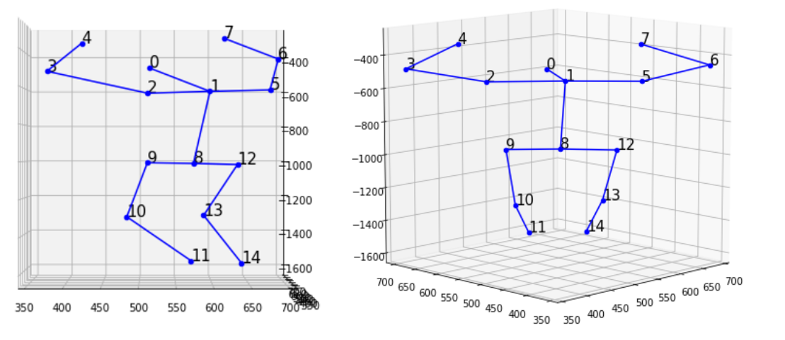
Exercise Pose Matching
Experimental results:
3D keypoint reconstruction
3D reconstruction affected by keypoint detection confidence threshold for multi-view matching.
Too high (> 0.7): Unable to detect keypoints
Too low (< 0.5): Noisy keypoints
Generate joint angles from 3D space (elevation,azimuth)
Notes:
What is the business problem that you will investigate?
Why is it interesting and useful?
What is its impact to Singapore?

Slide 29
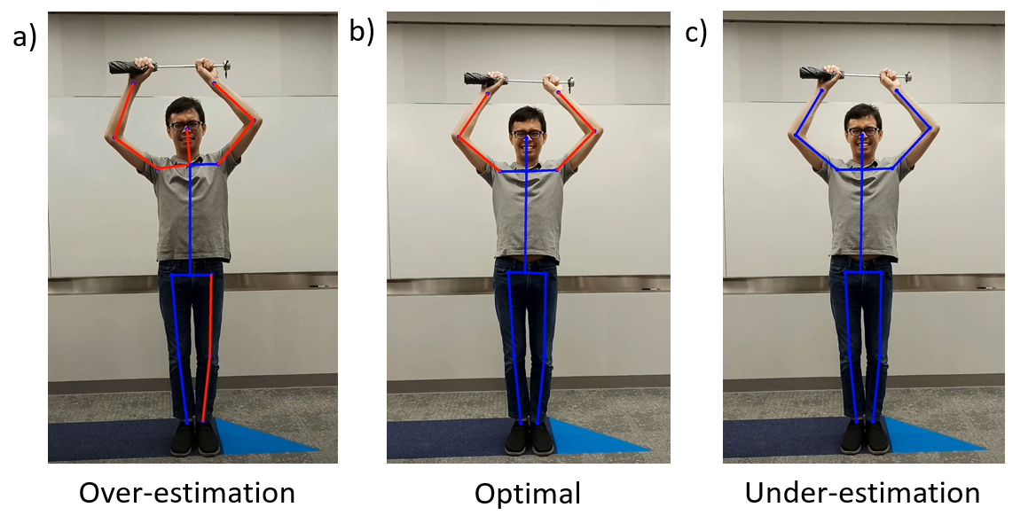
Exercise Pose Matching
Experimental results:
Joint angle matching
Angle difference threshold affects the sensitivity of the matching algorithm
Too high (>40 deg): Unable to detect errors --- (c)
Too low (<10 deg): Affected by small body movements and noisy keypoints --- (a)
Optimal (20-30deg) --- (b)
Notes:
What is the business problem that you will investigate?
Why is it interesting and useful?
What is its impact to Singapore?

Slide 30
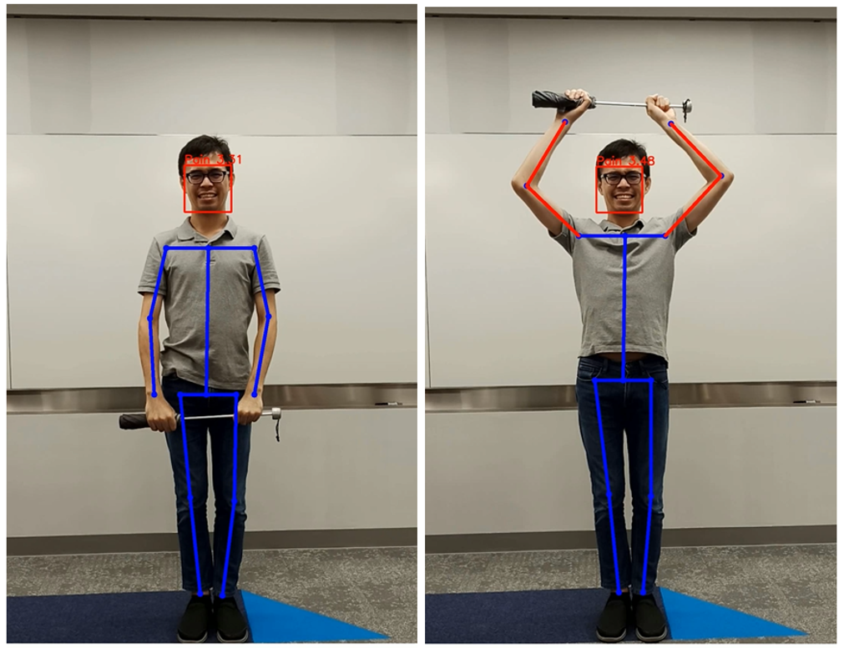
Exercise Pose Matching
Experimental results:
Positive / Negative testing of matching algorithm
Detected errors on when arms are raised
No error detected at other body joints or when arms are in downward position
Limitation / Future work
3D human body shape generation performed for individual frames
May lead to slight perturbations in body shape from frame to frame
Lead to added noise in joint angle matching
Further improvements could use frame-to-frame shape regression to stabilise body model in a video sequence.
Notes:
What is the business problem that you will investigate?
Why is it interesting and useful?
What is its impact to Singapore?

Slide 31
PAVE system

Slide 32
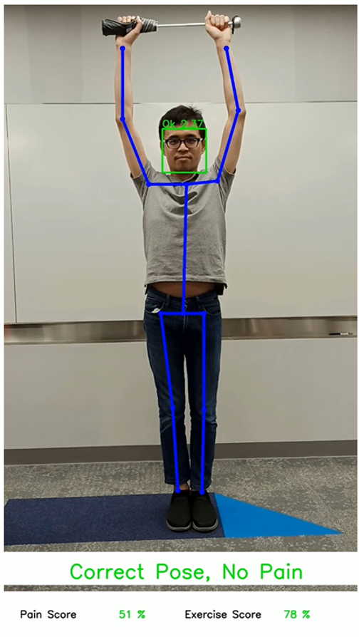
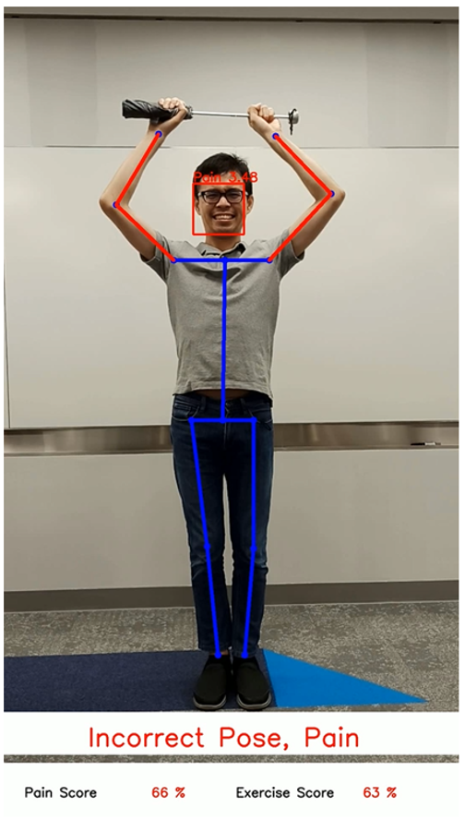
PAVE System
PAVE System fusion of developed modules
Pain scoring
Exercise scoring
Exercise pose matching
Achieved desired outcome of pain recognition and exercise accuracy evaluation from video inputs.
Visual: Joint error, pain expression
Quantitative: Pain score, Exercise score
PAVE system serves as demonstrator for automated sense-making solution for medical and wellness industries.
Notes:
What is the business problem that you will investigate?
Why is it interesting and useful?
What is its impact to Singapore?

Slide 33
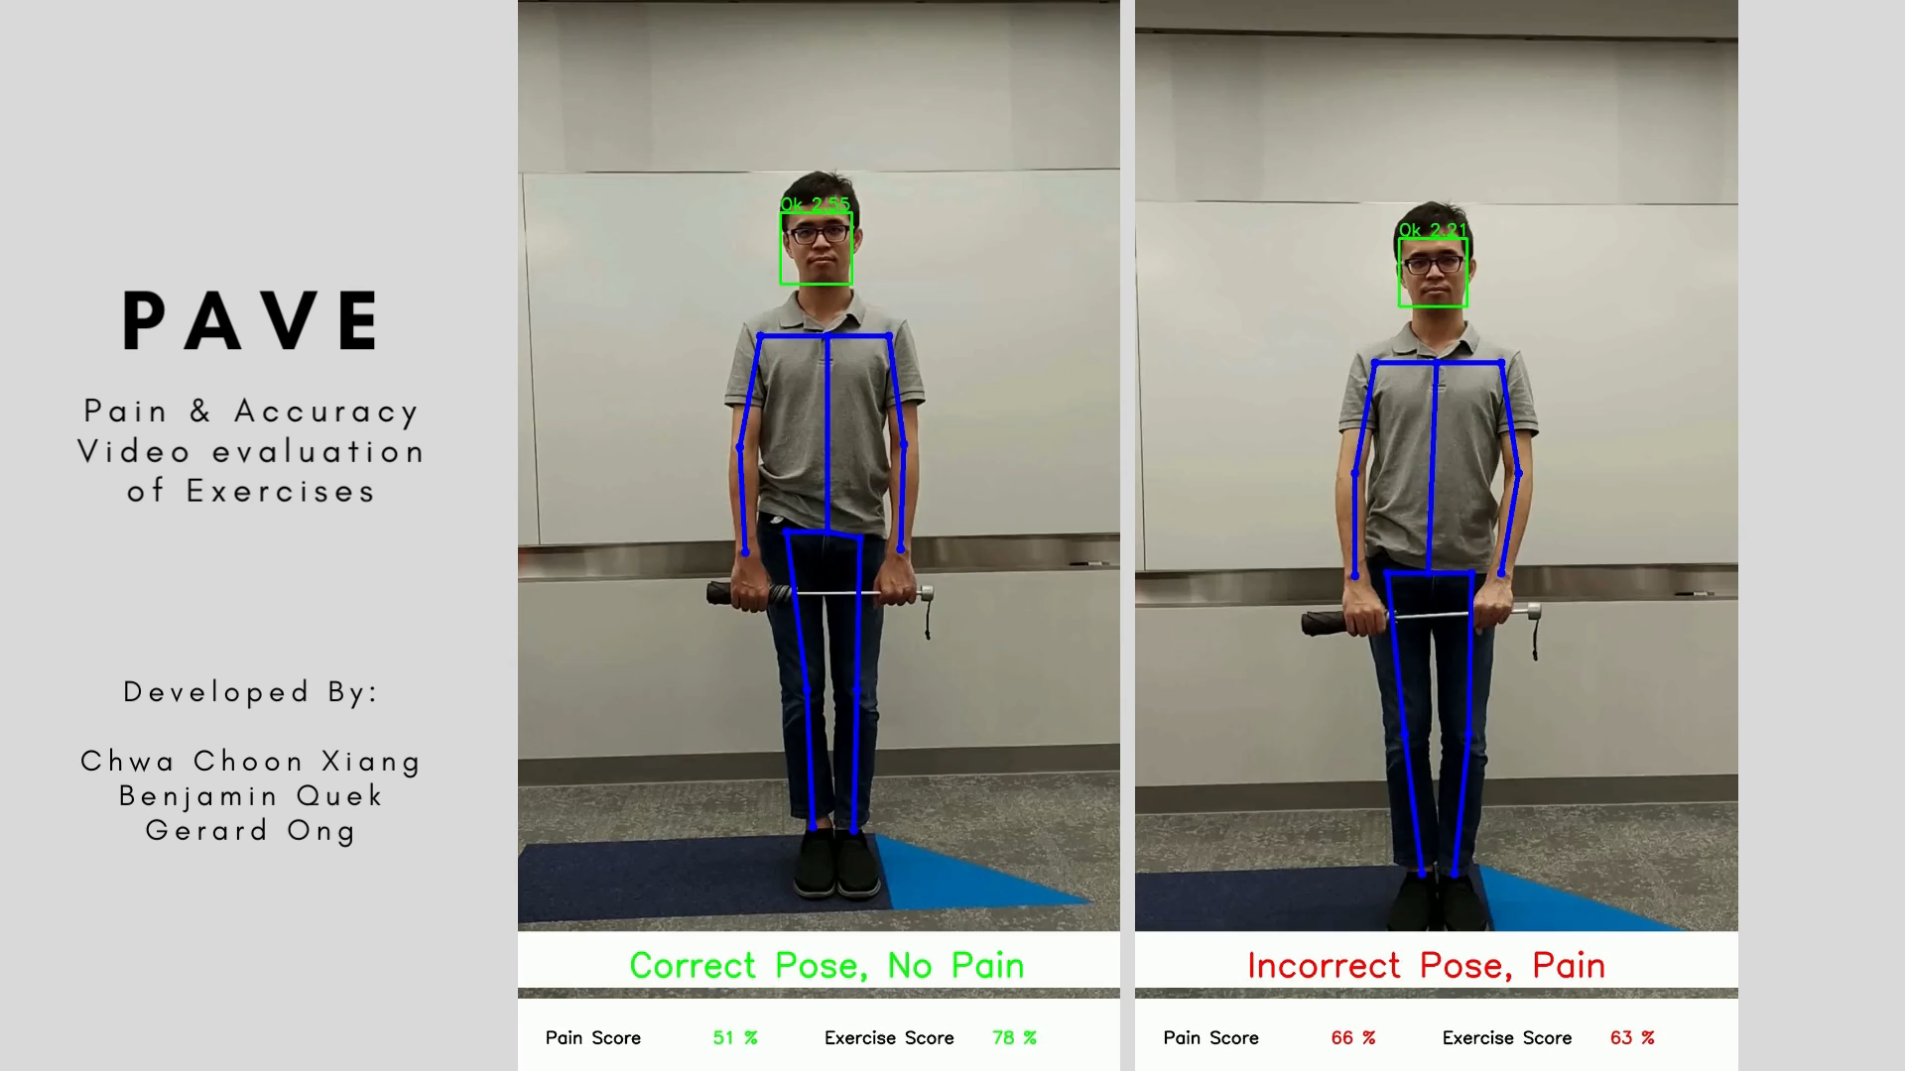
PAVE System
PAVE System demo
Notes:
What is the business problem that you will investigate?
Why is it interesting and useful?
What is its impact to Singapore?

Slide 34
References
Othman, E.; Werner, P.; Saxen, F.; Al-Hamadi, A.; Gruss, S.; Walter, S. Automatic vs. Human Recognition of Pain Intensity from Facial Expression on the X-ITE Pain Database. Sensors 2021, 21, 3273. https://doi.org/10.3390/s21093273
P. Lucey, J. F. Cohn, K. M. Prkachin, P. E. Solomon and I. Matthews, "Painful data: The UNBC-McMaster shoulder pain expression archive database," 2011 IEEE International Conference on Automatic Face & Gesture Recognition (FG), 2011, pp. 57-64, doi: 10.1109/FG.2011.5771462.
Bargshady, Ghazal & Zhou, Xujuan & Deo, Ravinesh & Soar, Jeffrey & Whittaker, Frank & Wang, Hua. (2020). Enhanced deep learning algorithm development to detect pain intensity from facial expression images. Expert Systems with Applications. 149. 113305. 10.1016/j.eswa.2020.113305.
Mende-Siedlecki, Peter et al. “The Delaware Pain Database: a set of painful expressions and corresponding norming data.” Pain reports vol. 5,6 e853. 21 Oct. 2020, doi:10.1097/PR9.0000000000000853
K. He, X. Zhang, S. Ren, and J. Sun, Deep Residual Learning for Image Recognition. arXiv, 2015. doi: 10.48550/ARXIV.1512.03385.
Capecci, M., Ceravolo, M. G., Ferracuti, F., Iarlori, S., Monteriu, A., Romeo, L., & Verdini, F. (2019). The KIMORE Dataset: KInematic Assessment of MOvement and Clinical Scores for Remote Monitoring of Physical REhabilitation. IEEE transactions on neural systems and rehabilitation engineering : a publication of the IEEE Engineering in Medicine and Biology Society, 27(7), 1436–1448. https://doi.org/10.1109/TNSRE.2019.2923060
Deb, S., Islam, M. F., Rahman, S., & Rahman, S. (2022). Graph Convolutional Networks for Assessment of Physical Rehabilitation Exercises. IEEE transactions on neural systems and rehabilitation engineering : a publication of the IEEE Engineering in Medicine and Biology Society, 30, 410–419. https://doi.org/10.1109/TNSRE.2022.3150392
Yan, S., Xiong, Y., & Lin, D. (2018). Spatial Temporal Graph Convolutional Networks for Skeleton-Based Action Recognition. Proceedings of the AAAI Conference on Artificial Intelligence, 32(1). Retrieved from https://ojs.aaai.org/index.php/AAAI/article/view/12328
A. Nagarkoti, R. Teotia, A. K. Mahale and P. K. Das, "Realtime Indoor Workout Analysis Using Machine Learning & Computer Vision," 2019 41st Annual International Conference of the IEEE Engineering in Medicine and Biology Society (EMBC), 2019, pp. 1440-1443, doi: 10.1109/EMBC.2019.8856547.
H. Xiong, S. Berkovsky, R. V. Sharan, S. Liu and E. Coiera, "Robust Vision-Based Workout Analysis Using Diversified Deep Latent Variable Model," 2020 42nd Annual International Conference of the IEEE Engineering in Medicine & Biology Society (EMBC), 2020, pp. 2155-2158, doi: 10.1109/EMBC44109.2020.9175454.
Choutas et al. (2020) Monocular Expressive Body Regression through Body-Driven Attention, ECCV’20
Tao, L., Paiement, A., Damen, D., Mirmehdi, M., Hannuna, S., Camplani, M., ... & Craddock, I. (2016). A comparative study of pose representation and dynamics modelling for online motion quality assessment. Computer vision and image understanding, 148, 136-152.
Dolatabadi, E., Zhi, Y. X., Ye, B., Coahran, M., Lupinacci, G., Mihailidis, A., ... & Taati, B. (2017, May). The Toronto rehab stroke pose dataset to detect compensation during stroke rehabilitation therapy. In Proceedings of the 11th EAI International Conference on Pervasive Computing Technologies for Healthcare (pp. 375-381).
Li, M. H., Mestre, T. A., Fox, S. H., & Taati, B. (2018). Vision-based assessment of parkinsonism and levodopa-induced dyskinesia with pose estimation. Journal of neuroengineering and rehabilitation, 15(1), 1-13.
Vakanski, A., Jun, H. P., Paul, D., & Baker, R. (2018). A data set of human body movements for physical rehabilitation exercises. Data, 3(1), 2.
Capecci, M., Ceravolo, M. G., Ferracuti, F., Iarlori, S., Monteriu, A., Romeo, L., & Verdini, F. (2019). The KIMORE dataset: KInematic assessment of MOvement and clinical scores for remote monitoring of physical REhabilitation. IEEE Transactions on Neural Systems and Rehabilitation Engineering, 27(7), 1436-1448.
Patil, S., Pawar, A., Peshave, A., Ansari, A. N., & Navada, A. (2011, June). Yoga tutor visualization and analysis using SURF algorithm. In 2011 IEEE Control and System Graduate Research Colloquium (pp. 43-46). IEEE.
Long, C., Jo, E., & Nam, Y. (2021). Development of a yoga posture coaching system using an interactive display based on transfer learning. The Journal of Supercomputing, 1-16.
Kanade, A., Sharma, M., & Manivannan, M. (2021). Tele-EvalNet: A Low-cost, Teleconsultation System for Home based Rehabilitation of Stroke Survivors using Multiscale CNN-LSTM Architecture. arXiv preprint arXiv:2112.03168.
Yan, S., Xiong, Y., & Lin, D. (2018, April). Spatial temporal graph convolutional networks for skeleton-based action recognition. In Thirty-second AAAI conference on artificial intelligence.
Deb, S., Islam, M. F., Rahman, S., & Rahman, S. (2022). Graph Convolutional Networks for Assessment of Physical Rehabilitation Exercises. IEEE Transactions on Neural Systems and Rehabilitation Engineering, 30, 410-419.

